Slide 1
Modeling the Pandemic - R and all that: Some basic concepts of the epidemiology of infectious diseases
After reviewing some basic virology, we continue laying the groundwork for understanding epidemic modeling by introducing some basic concepts of the epidemiology of infectious diseases
In the media people often talk about R, growth rates, etc.
What are they talking about? This is what you’re going to learn today
Pay attention because you can bet that you’ll be asked about some of that stuff in the midterm exam

Slide 2
Modeling the Pandemic - R and all that: Some basic concepts of the epidemiology of infectious diseases
We start by introducing the concepts of incubation period, generation time and serial interval
Incubation period: the time between the moment someone is infected and the moment they exhibit symptoms
Generation time: the time between the moment someone is infected and the moment they infect someone else (always > 0)
Serial interval: the time between the moment a person A, who infected a person B, exhibits symptoms and the moment B exhibits symptoms (can be < 0)

Slide 3
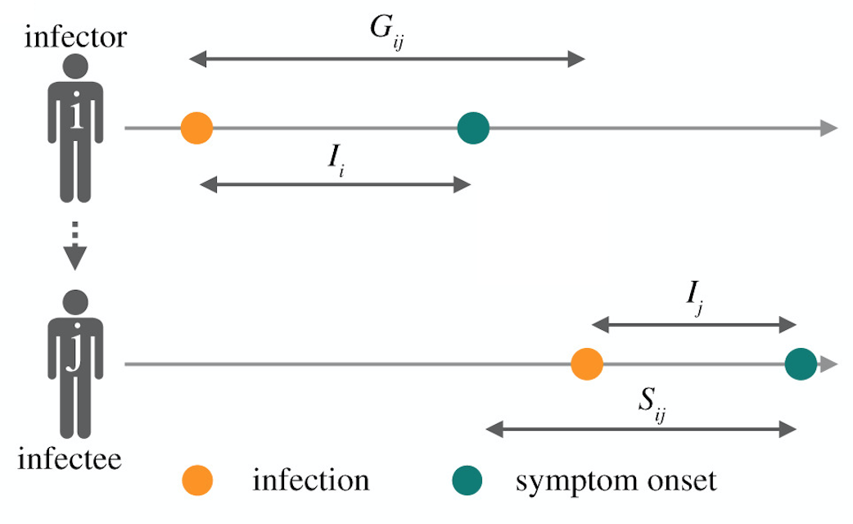
Modeling the Pandemic - R and all that: Some basic concepts of the epidemiology of infectious diseases

Slide 4
Modeling the Pandemic - R and all that: Some basic concepts of the epidemiology of infectious diseases
Each of those quantities has a different value for different people and even for the same people in different instances
But the value each of them takes in any particular case is drawn from a probability distribution
A probability distribution, roughly, tells you how likely it is that a quantity of interest will take any range of values
The mean of a distribution is the average value that quantities that follow that distribution take
The standard deviation of a distribution measures how far from the mean the values it can take are on average

Slide 5
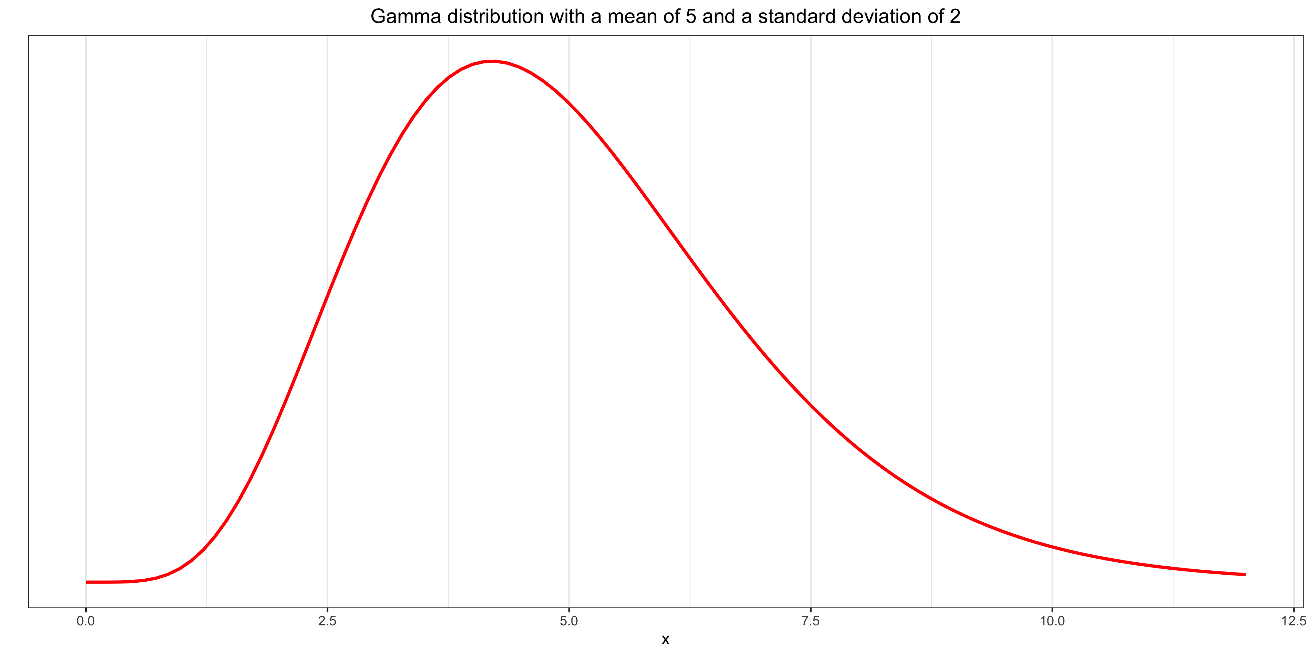
Modeling the Pandemic - R and all that: Some basic concepts of the epidemiology of infectious diseases

Slide 6
Modeling the Pandemic - R and all that: Some basic concepts of the epidemiology of infectious diseases
The distribution of those quantities can and frequently do change over time
In the case of the incubation period, it can change because different variants of the virus can lead to symptoms more or less quickly
In the case of the generation time and the serial interval, it can change because, for instance, tests have become more readily available

Slide 7
Modeling the Pandemic - R and all that: Some basic concepts of the epidemiology of infectious diseases
At the beginning of the pandemic, estimates of the incubation period ranged from 3.6 days to 9.1 days depending on the data and methods used
Estimates of the generation time and the serial interval ranged from 3.95 days to 7.5 days
Now estimates are even more all over the place

Slide 8
Modeling the Pandemic - R and all that: Some basic concepts of the epidemiology of infectious diseases
Basic reproduction number or R₀: the average number of people that someone who is infected would go on to infect in a population where everyone is susceptible
We can’t directly observe it because it’s never the case that everyone in the population is susceptible
But the situation at the beginning of the epidemic comes pretty close, which is why it’s typically measured at the beginning of outbreaks, although there are other methods

Slide 9
Modeling the Pandemic - R and all that: Some basic concepts of the epidemiology of infectious diseases
Despite what you often hear, even from epidemiologists, this is not an intrinsic property of the virus, so it makes no sense to talk about the basic reproduction number of SARS-CoV-2, influenza, measles, etc.
It depends on many things that can be and are in fact different in different populations, such as culture, behavior, population density, etc.
Even in the same population, it can be different at different times, because those things can vary over time for all sorts of reasons
It’s also difficult to estimate and, as a result, estimates for the same population during the same period are often all over the place

Slide 10
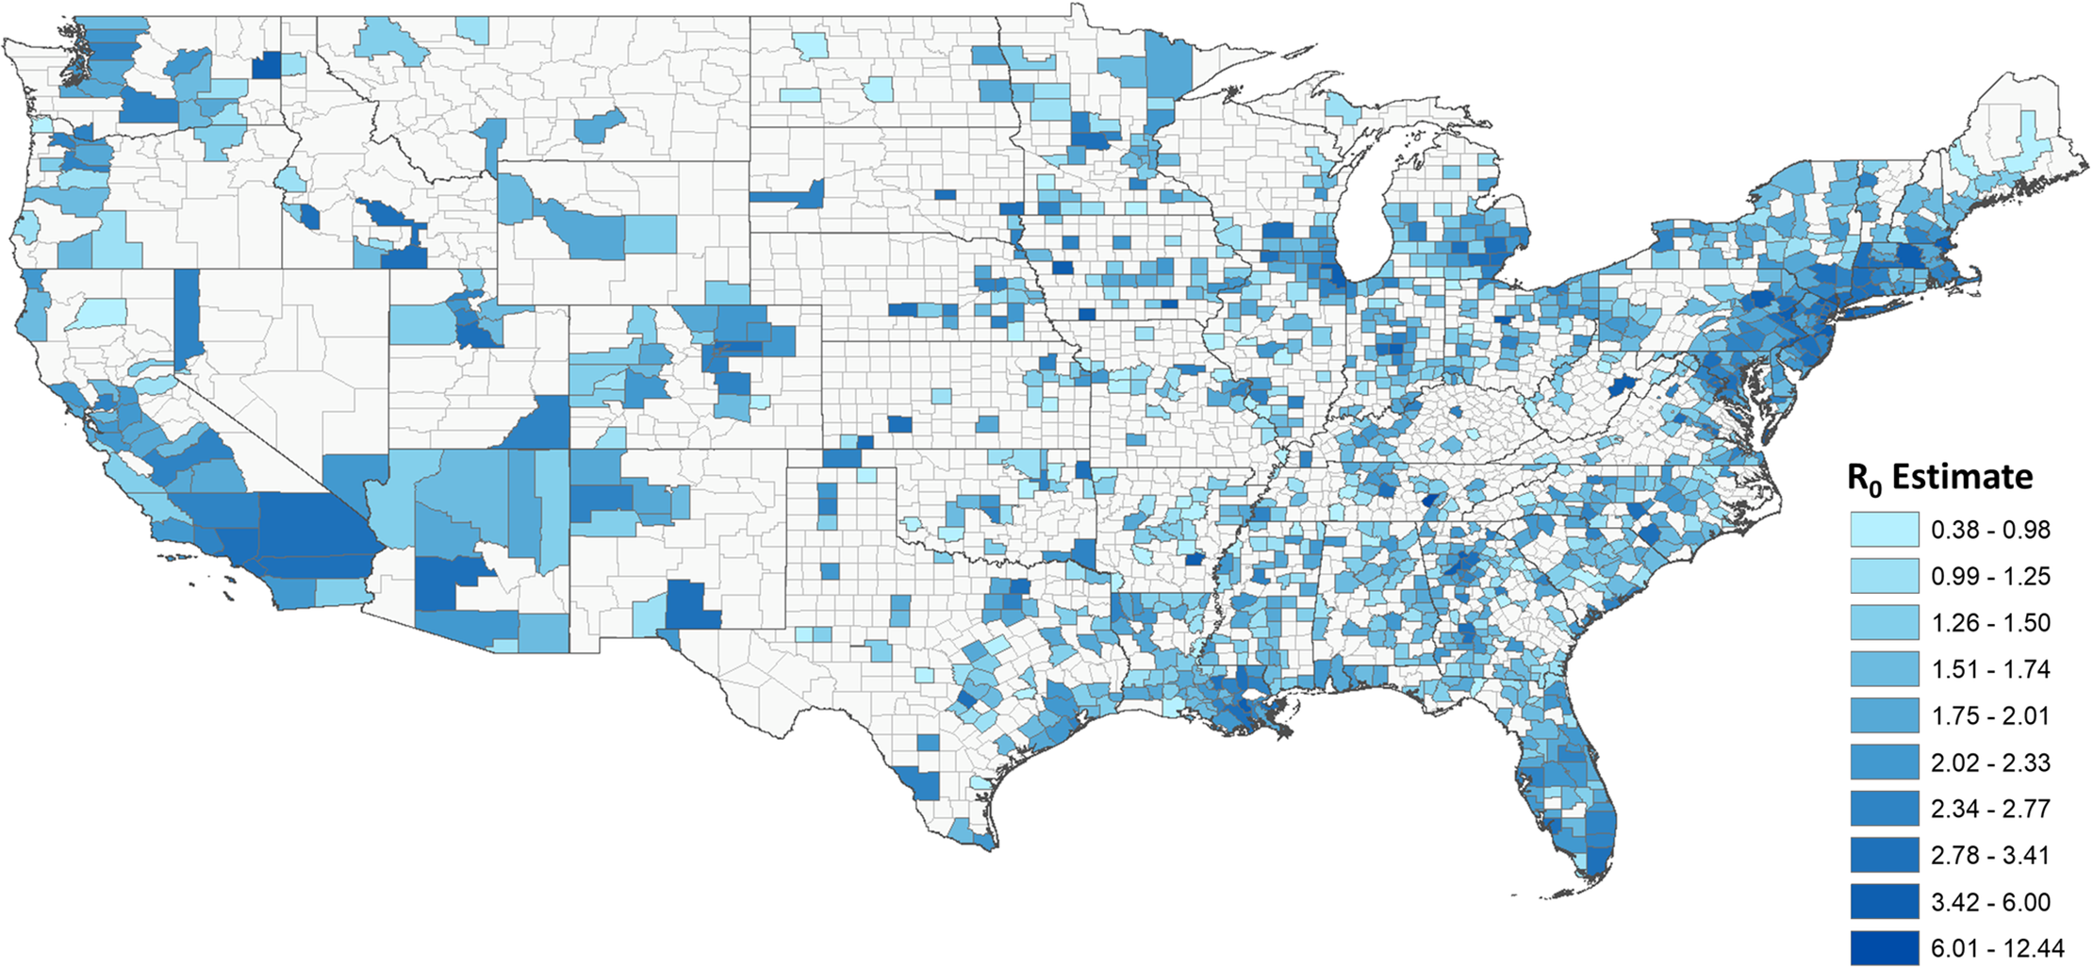
Modeling the Pandemic - R and all that: Some basic concepts of the epidemiology of infectious diseases

Slide 11
Modeling the Pandemic - R and all that: Some basic concepts of the epidemiology of infectious diseases
Effective reproduction number of R_{t}: the average number of people a person who is infected at time t will go on to infect
Unlike the basic reproduction number, this refers to the actual situation at a given time, not a hypothetical situation in which everyone is susceptible
It’s different from the basic reproduction number because, if everyone were susceptible, some people that were not infected despite being exposed would have been infected

Slide 12
Modeling the Pandemic - R and all that: Some basic concepts of the epidemiology of infectious diseases
As long as the effective reproduction number is greater than 1, the daily number of infections increases
When it goes below 1, the epidemic starts to recede
Whether the basic reproduction number is greater than 1 will determine whether there will be a sustained epidemic in the first place

Slide 13
Modeling the Pandemic - R and all that: Some basic concepts of the epidemiology of infectious diseases
The number of people that someone who is infected goes on to infect also follows a probability distribution (R is just the mean of that distribution)
It’s often modeled with a negative binomial distribution (you don’t have to remember that), which allows us to model the fact that a small share of infected people can be responsible for a large share of secondary infections (superspreading events)
This distribution has a parameter k, called the dispersion factor, that measures how concentrated on a few people transmission events are
The lower k is, the more a small number of people are responsible for a greater share of secondary infections and

Slide 14
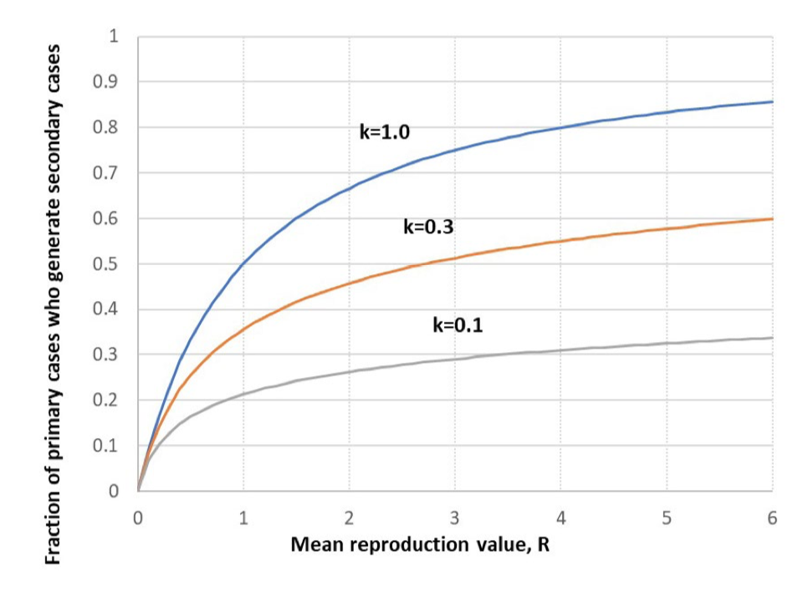
Modeling the Pandemic - R and all that: Some basic concepts of the epidemiology of infectious diseases

Slide 15
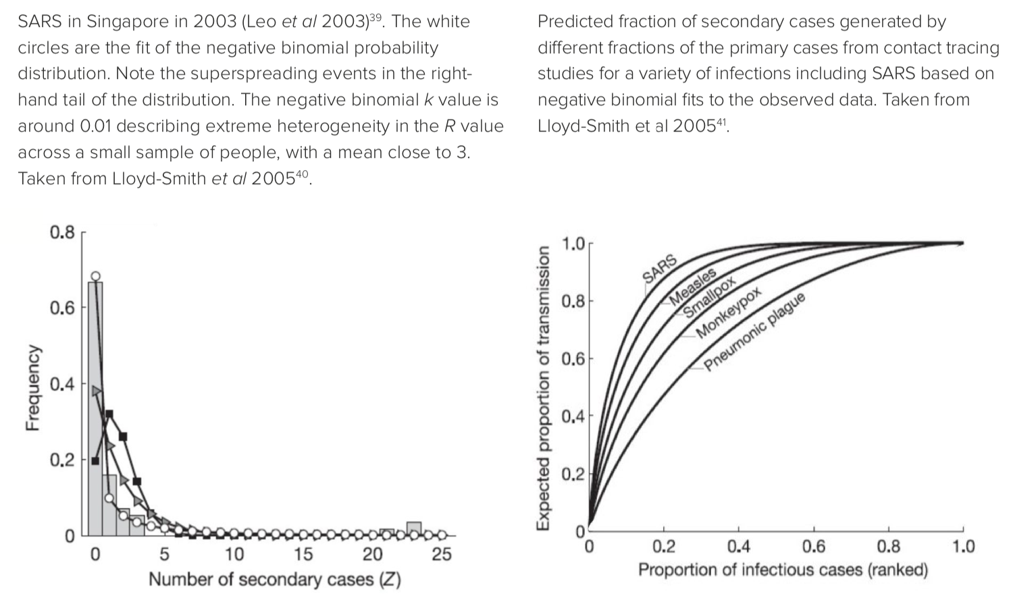
Modeling the Pandemic - R and all that: Some basic concepts of the epidemiology of infectious diseases

Slide 16
Modeling the Pandemic - R and all that: Some basic concepts of the epidemiology of infectious diseases
Rate of growth of the epidemic = r = (number of infections at time t + 1 / number of infections at time t) – 1
Example: 1000 infections on day n, 1100 infections on day n + 1, daily growth rate = 1100 / 1000 – 1 = 10%
Note: we don’t observe infections, only diagnosed cases, but under reasonable (at least for short periods of time) assumptions, it doesn’t matter for the rate of growth
For instance, suppose that we only detect 50% of infections on day n and same thing on day t + 1, then the daily growth rate we get is going to be equal to 550 / 500 – 1 = 10% (same as before)
Despite what people on both sides often claim, changes in the number of cases are actually a very good indicator of changes in the number of infections

Slide 17
Modeling the Pandemic - R and all that: Some basic concepts of the epidemiology of infectious diseases
What is the relationship between r (rate of growth) and R (reproductive number)?
You can find different equations in the scientific literature
For instance, sometimes people use the equation R = 1 + rT and sometimes the equation R = exp(rT), where T is the mean generation time
But those can lead to very different conclusions about R!
For example, in the case of hepatitis C, r = 9.6% per year and T = 20 years, so R = 1 + 0.096 * 20 ≈ 2.9 according to the first equation but R = exp(0.096 * 20) ≈ 6.8 according to the second

Slide 18
Modeling the Pandemic - R and all that: Some basic concepts of the epidemiology of infectious diseases
Beside those 2 equations, you can actually encounter many other equations that relate r to R in the scientific literature and they can make a big difference, so what is going on?
The actual relationship between r and R depends on the generation time distribution and people make (usually implicitly) different assumptions about it
The first equation assumes that the generation time follows an exponential distribution, while the second assumes it’s always the same
Note: in both cases, the mean can be the same, but remember there is more to a probability distribution than its mean!
We often don’t know what the actual relationship is, because we don’t know what the generation time distribution is, so there is a lot of uncertainty that people generally sweep under the rug

Slide 19
Modeling the Pandemic - R and all that: Some basic concepts of the epidemiology of infectious diseases
Nevertheless, regardless of what the actual relationship is, there are some things we can say about it
In particular, it’s always the case that r is inversely related to the generation time, i. e. the shorter the generation time the larger the growth rate keeping R equal
Moreover, the higher R is, the larger the growth rate keeping the generation time equal
Think about population growth: a country’s population grows faster if people make more kids but also if they have kids earlier
It’s the same thing with viruses (this is where "generation" in "generation time" comes from!)

Slide 20
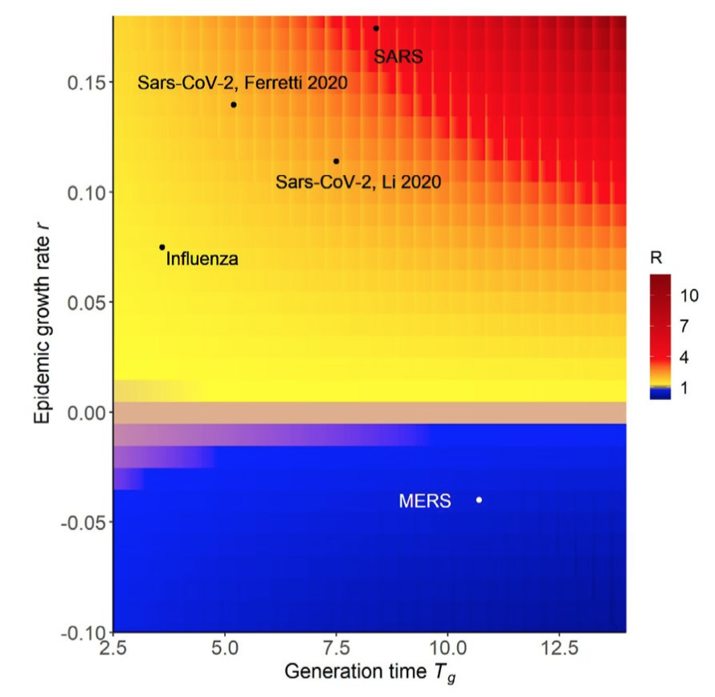
Modeling the Pandemic - R and all that: Some basic concepts of the epidemiology of infectious diseases

Slide 21
Modeling the Pandemic - R and all that: Some basic concepts of the epidemiology of infectious diseases
This means that a variant can grow faster than another even if they have the same R
For instance, it seems that Omicron has a shorter generation time than Delta, so even if it didn’t also have a higher R, it would still grow faster
It’s important because it’s R, not r, that determines the size of the wave
That being said, r is still important, because a higher r could overwhelm hospitals faster even if R and therefore the eventual size of the wave were the same

Slide 22
Modeling the Pandemic - R and all that: Some basic concepts of the epidemiology of infectious diseases
Epidemic doubling time: how much time it would take for the cumulative number of infections to double if the epidemic grew at a constant rate
It’s equal to ln(r) / 2
It’s important to keep in mind that in practice the growth rate never remains constant for very long and, even in theory, it only does so at the beginning of the epidemic

Slide 23
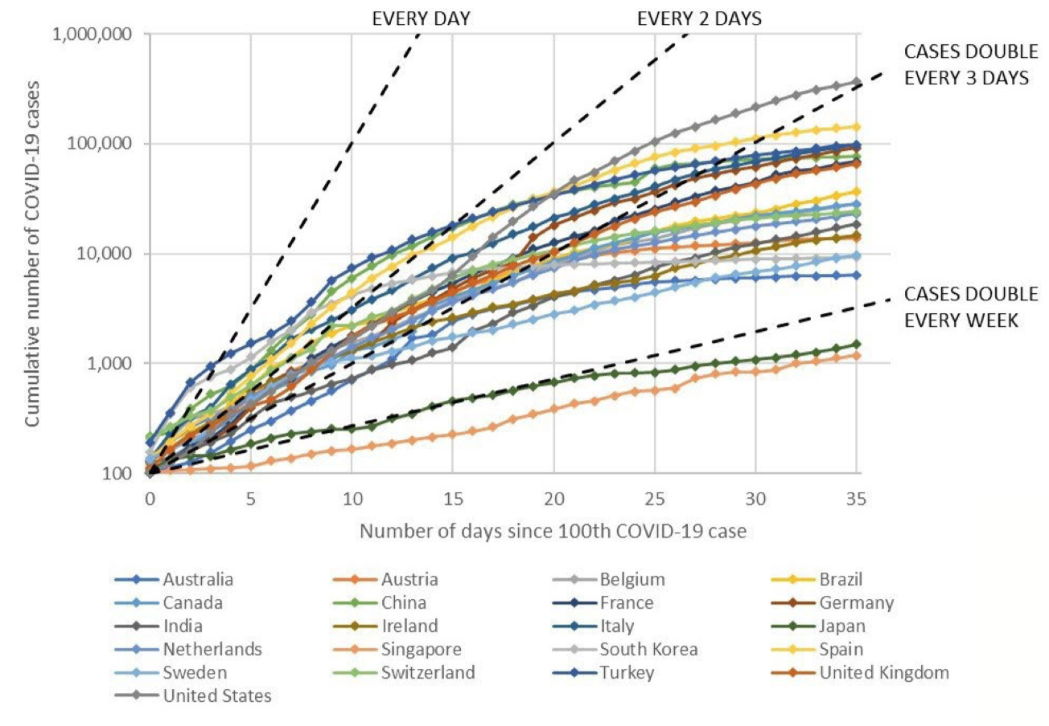
Modeling the Pandemic - R and all that: Some basic concepts of the epidemiology of infectious diseases

